Slide 1

Progressive Web Apps Architectural Pattern
CSI 5510 ADVANCED WEB DESIGN & APPLICATION
Presented By – Prasanna ujwal sasne
Date: 03/ 14/ 2021

Slide 2
Background / history
Native applications – 2008
Google play store, App store were released in 2008. The speed of the internet on phones was very slow, and still, the price was quite high for data usage. For this reason, many companies started developing Native Apps. These apps provided a quick and smooth experience to users, but the cost for development and specialization was very high.
Native apps were developed in different programming languages on so many different devices, and many companies decided to specialize these apps in specific platforms. e.g.(Apple, Windows, Android). Native applications had the access to a huge set of APIS e.g.(Push notification, background sync, 2-factor authentication, etc..) to connect with devices.
Responsive Web design – 2008
With the rise of Native App, responsive web applications have become another method that people pay attention to. Using these web pages can render nicely on different types of devices and windows of different screen sizes.
But "web apps" built this way would just be simple websites and would require the user to access the internet, and specifically access the site URL[ref 1]

Slide 3
Hybrid App development – 2010
Hybrid apps are written in JavaScript, Html, CSS. But it also requires additional knowledge of languages like iOS, Swift, Java for Android. This is just a web app that is wrapped in a native container and runs from an embedded browser.
It is written once and deploy everywhere app to be compatible with distinct platforms but is slower than native apps and relies on browser security.
PWA (Progressive Web apps) - Current
PWAs are designed to bridge the gap between web development and native app development by improving the user experience. It is considered a new contender to web apps.
PWA’s, are websites that look, feel and work like a mobile app. Like any conventional website, a PWA is accessed using a specific URL, after which users can navigate through the app, like a mobile app.
Installing PWA will add an app-like icon on the home screen of mobile which feels like a native app.
PWAs are designed to work on any platform which includes desktop and mobile devices. Google introduces “Progressive Web Apps” and in 2015, the name “Progressive Web Apps” was coined by Chrome developer Alex Russel.

Slide 4
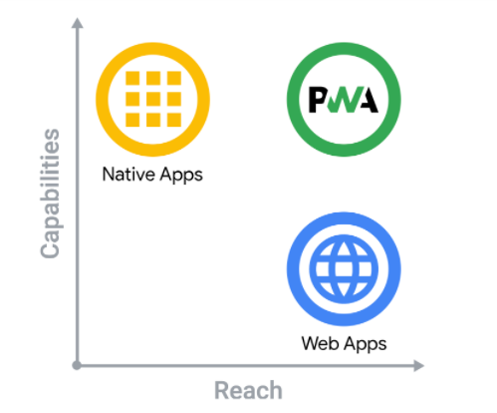
Basics of PWA
This image shows Google’s vision on Progressive Web Apps versus Web and Native apps. As PWAs are being designed to fill the gap between them.
Can access cameras and GPS of mobile devices and can work offline.
Can send push notifications to screen(e.g., New notification in a specific app, or a reminder to use the app), provide background synchronization, and can load UI screen quickly.
No need to download an app from the play store, no memory space wastage. As a full setup website with PWA, will prompt users as “install now” (Slide 10) action, and once clicked app will be downloaded on a mobile screen.
Progressive Web Apps (PWAs) utilize modern APIs to provide improved capabilities, reliability, and installability while reaching anybody, anywhere, on any platform with a single codebase.

Slide 5
Can be developed using front-end technologies like Vue, React, Angular, and JavaScript and these are platform-independent.
Small firms cannot afford a native mobile app due to several factors like cost, development time, resources, etc., So PWA would be the best choice for small firms as its development cost is less, it is independent of OS-specific App development.
Nice user experience even in very slow internet connection or no connection at all.
These apps are always up-to-date because of service workers.
It's safe because it's delivered over TLS (Transport Layer Security), which prevents snooping and ensures that the content hasn't been tampered with.
Using service workers and web apps manifest a web app becomes reliable and downloadable.
Users do not need to deal with possible geographical restrictions of app stores as they can share links of PWA directly.
Overall concept - PWAs are web apps that load like standard websites but give users the experience of a native app(an example is on slides – 10, 11). It will run on any computer with a standards-compliant browser, which includes both desktop and mobile devices. They also have additional useful features such as push notifications and background synchronization.

Slide 6
the key components / techniques
There are several advantages of PWA’s. Key components of PWA are listed below along with its functionality
Working In Offline Mode
Even in the no network zone we can access Google Maps Go, though you can not search for new locations, you can still see the UI and nearby locations. Once the smartphone catches the signal and can access the internet it will update new data, and this is achieved by using service worker’s update process.
On the internet, PWA provides the same functionality. When we try to load the website without having internet access, we get the message "you are offline" (e.g., YouTube, Google home page, etc.) But PWA allows you to access the website even though you are not connected to the internet (Provided user should have visited the website at least once before, in an online mode). As it is enhanced with service workers to work offline or on low-quality networks.
Platform independent - Progressive Apps
Native mobile apps are platform-dependent and can be accessed from their respective OS like Android or iOS, on the other hand, PWA’s are not platform-dependent since they are browser-based and hence can run on any OS.

Slide 7
Background synchronization
While mobile apps often require you to reinstall or upgrade them in order to incorporate new or additional functionality, progressive web apps update their content in the background, and new features/updates are automatically integrated into the website with a simple page refresh.
Even though no-internet connection zone, the user can open the application successfully and he/she does not need to keep staring at a white screen or a spinner till the application gets open. E.g., the user can also send messages in offline mode and once the user’s device gets connected to the internet then messages will be sent in the background.
Overall, Background synchronization is used to process or make a request to fetch data even though there is no internet link.
Purpose of background sync[ref 2] –
To send any data, such as chat messages, emails, document updates, settings changes, photo uploads, or anything else, to the server even if the user navigates away or closes the tab. The page could save them in an indexed database "outbox," and the service worker would retrieve and send them.
If a user has requested data from an application, he or she is not required to wait for the response. User can keep their phone aside and keep working on another task, knowing that their phone will alert them when it has retrieved the information they requested.

Slide 8
Continue…
Background synchronization workflow - when a user sends a request to the server via the app in the absence of a network connection, the request is cached. The request is saved in the cache even if the user closes the app after making it.
The request is executed as soon as the network connection is restored, and the app is populated with the requested data in the background.
This process requires the help of a service worker to enable this functionality even if the app is not opened. For this registration of service-worker is important, and after successful registration of it, its sync task will listen to an event. And this sync task gets executed when the connection is present.
When there is no internet connection, the request is stored in a client-side API called IndexedDB, no backend call is initiated. When the connection is restored, the browser retrieves data from the IndexedDB and sends it to the server, complete the request.
Push notifications
A PWA also has push alerts, which are pop-up boxes that encourage user action on touch, such as a pop-up for subscribing to a specific feature (except iOS). Using this function, you can add a PWA shortcut icon to your desktop home screen that connects to a website.
Web push notifications can give timely updates to users from the sites they love, or we can say these are simplified messages that alert the recipient to perform a certain action.

Slide 9
Continue…
The alert may be created while the user is online or even after the app or browser has been closed. Push Notifications provide users with real-time alerts, which increases app interaction.
‘Push’ and ‘Notifications’ use complementary but different APIs. Service workers operate in the background and push is based on it. When a user clicks on notifications by clicking it or closing it, this is the only time when code runs for push notification or we can say the only time the battery is used.
Every browser has its own push notification service. The Push service is responsible for processing the notifications as well as routing them to the appropriate clients.
When a server provides information to a service worker then push is invoked till that time service worker remains in idle state. A notification is the action of a web page script or a service worker showing information to a user.
Push notifications work in 3 steps:
Users need to subscribe for notifications, and the app also checks for the existing subscription of the service workers. If the service worker has already subscribed to push alerts, the notifications are shown immediately.
Once the user subscribed for notification then messages will be sent from server to user browser.
Incoming messages will be queued if a browser is offline till it becomes online. And these messages will be handled by the service worker to show the notification.[ref 4]

Slide 10
When the app is reconnected to the internet, the push notification in the service worker is triggered. The service worker awakens from its idle state, displays the message, and then returns to sleep.
When the user interacts with the alerts, the service worker wakes up again.
Service Worker
It is a client-side programable proxy between the web app, the browser, and the network (when available). It is a type of web worker and each executes its script separately from the main browser thread.
It has a life cycle independent of the web app. It can receive messages when not active either because your application is in the background, not open or the browser is closed.
Service workers enable applications to control network requests, cache those requests to improve performance and provide offline access to cached content.[ref 3]
To use the service worker (it has an sw.js file), we need to register it from our web app(it has a main.js file). Registration tells your browser where does the service worker is located and to start installing into the background.
You can attempt to register a service worker when every time the page loads and the browser only complete the registration if the service worker is new, or it has been updated otherwise the existing service worker will remain active.

Slide 11
Continue
Web Workers allows you to run a script (e.g., JavaScript) operation in a background thread separate from the web application's main execution thread and the service worker is one of its types. Furthermore, the Service worker works along with several APIs to provide a native app-like feature.
The primary responsibility of a service worker is to use the browser API to pre-load content and serve it to the user. It is also responsible for loading offline content.
Service workers not only pre-cache the components of our application, but they also give some abilities to the web app, such as handling requests made by the network, the capability to handle more than one cache, and the ability to minimize the data traffic.
An app's offline feature can be implemented using IndexedDB, a client-side storage solution.
The service worker only intercepts the network request within its scope. E.g., sw.js is in the root directory the service worker will control requests from all the lower directories.

Slide 12


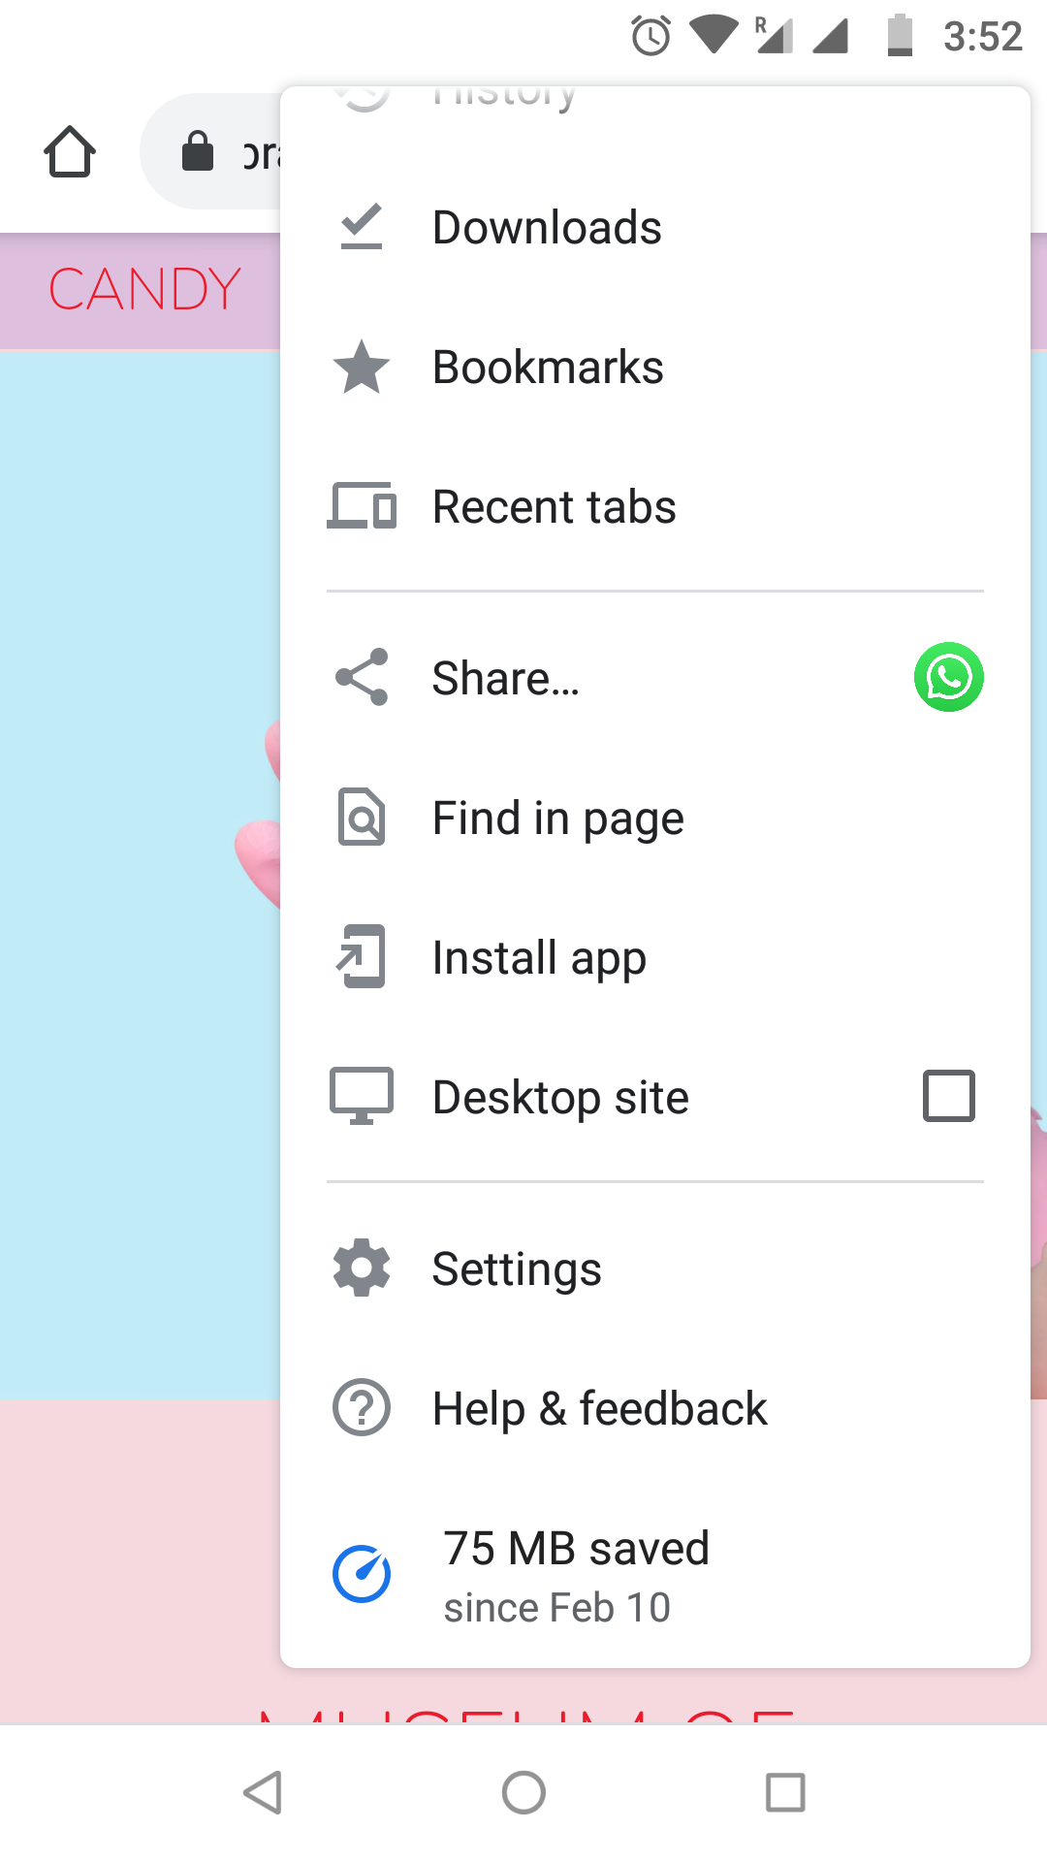
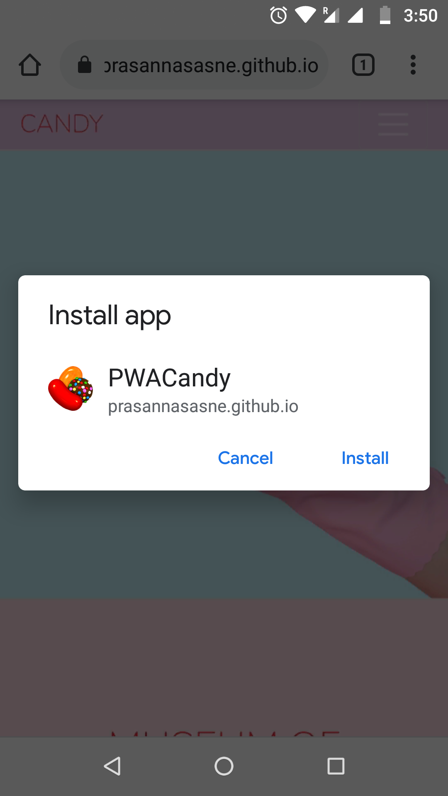



PWA Example – museum of candy
Web app manifest
Enables web app to have a more native-like presence on the user's home screen. It helps the user to run the app in full-screen mode (without a URL bar being present)
It is also used to define a set of icons by size and density for the Splash screen and home screen icons described earlier.
When the user navigates to the PWA website, it will give the option for installing the app.
Once installed, it will add the app icon to the home screen just like a native mobile app.

Slide 13
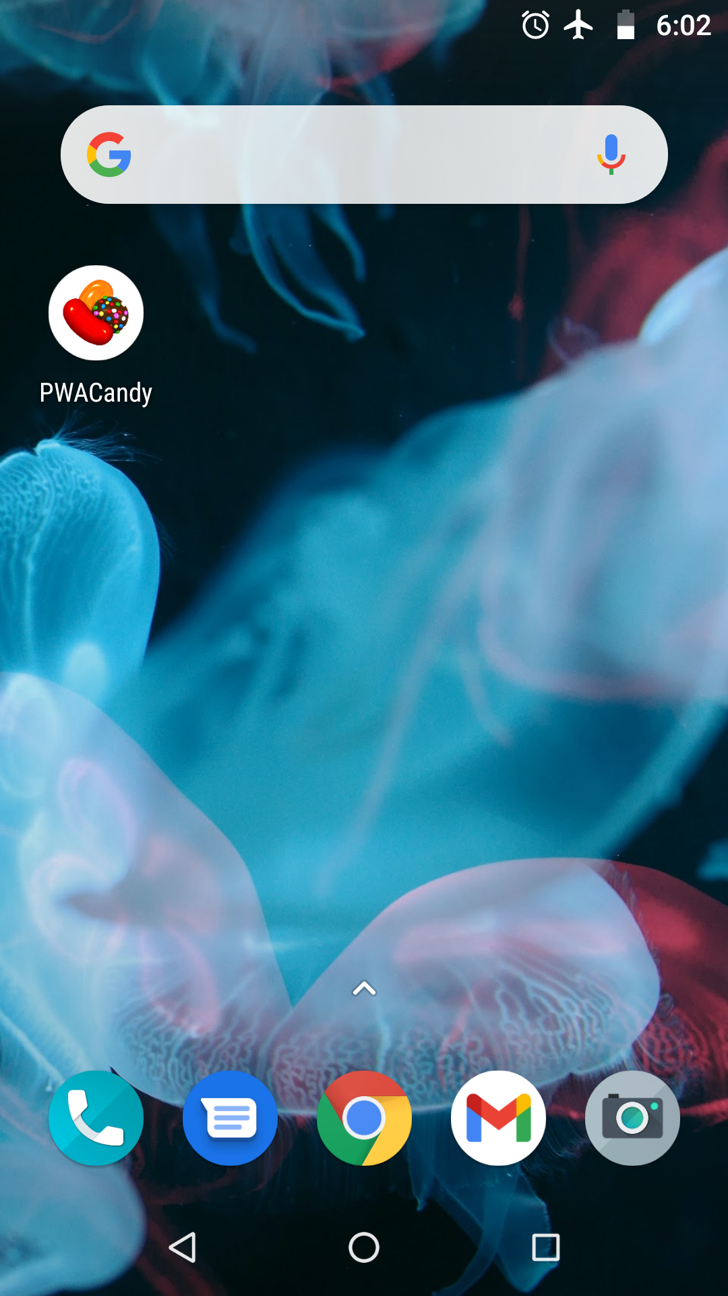
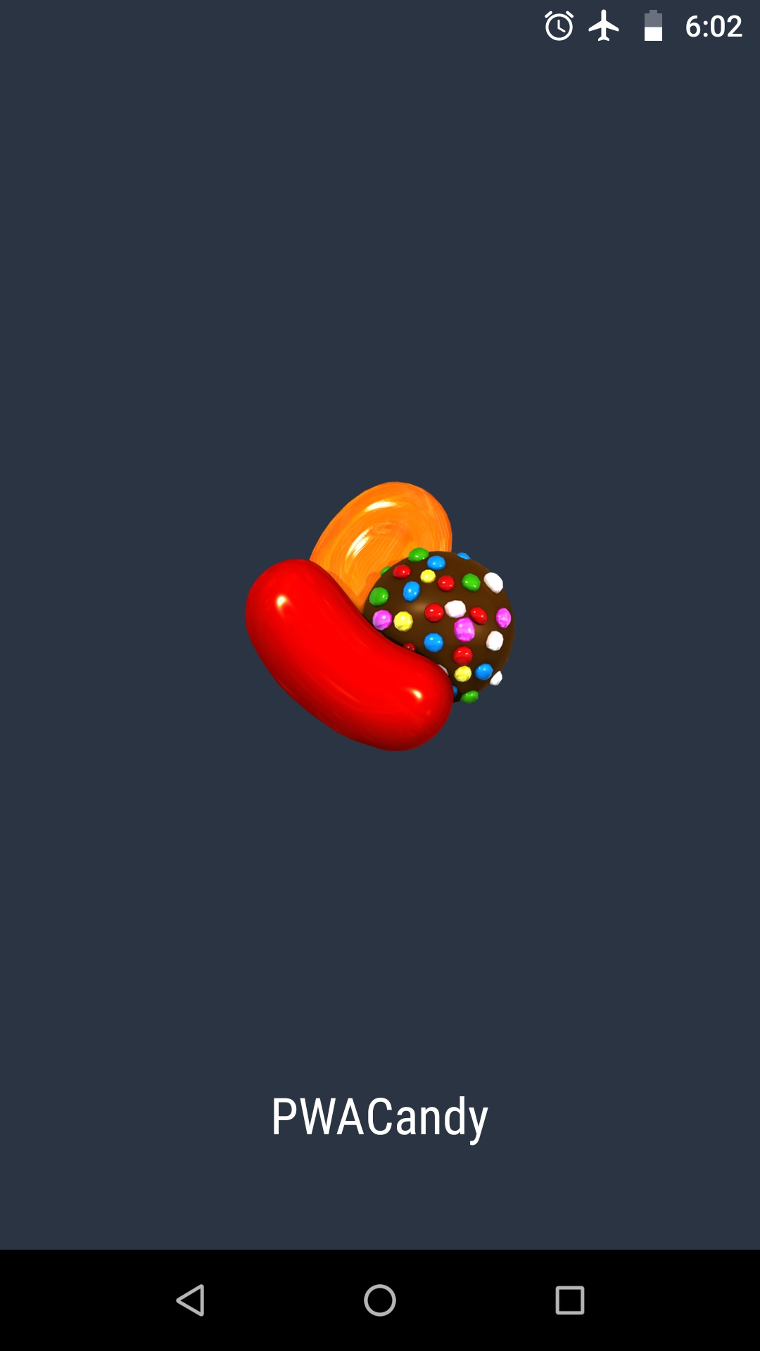


PWA Example – museum of candy
As mentioned earlier, Service Worker is a script that runs in the context of the browser without having user interaction. You can use Cache API to monitor the page's network traffic, manage push notifications, and create "offline first" web applications with this script.
As shown in the above example users can access the candy-project without having internet also, and this can be achieved with the help of service worker. Find code for this project here

Slide 14
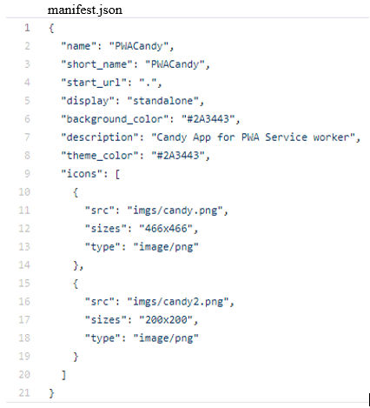
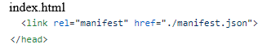
The demo app Implementation Details
Converting existing web app into PWA
I am using a simple bootstrap-based website for converting it into a PWA so that it should work on low internet or no-internet zone. You can use any web app with any framework to convert it into PWA.
There are two main steps to convert a plain web app into a PWA(Progressive Web App): adding a Service Worker(ws.js) and adding a Web App Manifest (manifest.json).
manifest.json we will add to the root of our application. This file is simple, where we can describe our application, its colors, and icons of different sizes. These icons will be displayed on the Mobile/Desktop screen once the app is installed.
Save the file and insert the following link in index.html just before the </head> tag.
This will help to identify your site as an application to the browser. You can check this by inspecting the web page and opening the application section. It will show you icons that you have added to the manifest and the whole manifest JSON file.

Slide 15
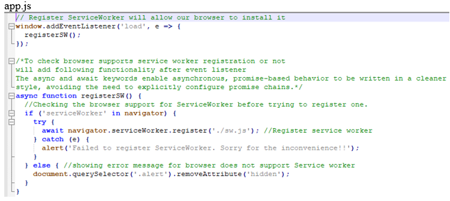
Service worker registration
The Web App Manifest tells the browser that our website is an app. The service worker (More info - slide 9) is the final piece of the puzzle, the one that will turn our simple, old website into something more powerful, such as the ability to load offline.
In the root of your application create an empty sw.js file, and in order to register it with our application so that browser can install it. Go to the app.js and add an event listener for service worker registration.
You can check this registered sw.js in DevTools, example is given on the next page.

Slide 16
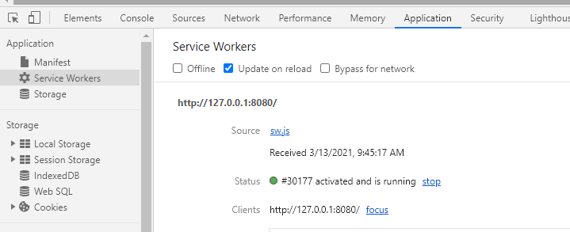
DevTools always updates the service worker on any page reload when this checkbox is enabled. When actively constructing a service worker, this is extremely helpful.
Now, we have a service worker registered, let's put it to work by caching some data.
As we have learned from previous slides, service workers are totally event-driven that means it would not run any code until it is responding to an event. There are two main events:
install - It is triggered when a new ServiceWorker(sw.js) file is detected in the root directory
fetch - any change in the ServiceWorker(sw.js) file will trigger a new install event to allow you to update the app.
We can listen to them by adding given code in sw.js.

Slide 17
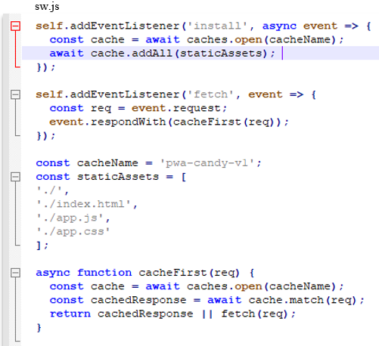
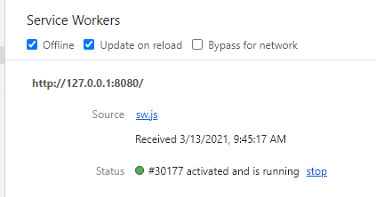
caches.match(req)
This takes the current web request that triggers the fetch event and checks in the cache for matching resources.
Even if the file isn't located in the cache, the match method returns a resolved promise object. Or if you do not find any file you simply want to fetch it from the network and return it to the browser.
An ‘install’ event gets triggered when the user hits the web page for the first time for the registration of a service worker. And this event is where you want to cache your page assets like index.html, app.js, etc.
Now, open DevTools and check the offline checkbox, refresh the webpage. You should see the app as if you are online, no more dinosaur page for saying you need a network to connect.
Other existing examples for PWA:
BookMyShow, Voot Lite, MakeMyTrip.com, George.com has already implemented the PWA for enhancing the load time and accessibility to work in low network zone for increasing Conversion rate.

Slide 18
More Supporting Examples for PWA
BookMyShow
With over 50 million monthly users, BookMyShow is India's largest entertainment ticketing website. They revamped their mobile website with PWA and saw a nearly 80 percent rise in conversion, which means more users are purchasing tickets.
Challenges of a native app – Over 85% of transactions done on mobile. Their native apps were consuming more memory and required heavy data to work effectively. Users of this app were unhappy as it uses more memory and data. On the other hand, the web app was also not working up to the mark like a native application.
Solution - Considering these factors, BookMyShow implemented the PWA and enhanced the user experience by allowing users to check out in 30 seconds as this loads only in 2.94 seconds. The latest PWA app is just 440KB in size, which is 54 times smaller than a native Android app and 180 times smaller than an iOS app[ref 5].
When a user requests a specific page, only the assets needed for that page are loaded, saving data. To deliver reliable performance on slow and unreliable performance it uses service workers.
The initial load time on 2G networks is just 4 seconds. Even for personalized movie recommendations, subsequent loads of the PWA take less than 2.94 seconds. Data consumption is also substantially lower because of PWA optimization.

Slide 19
George
George.com is a popular clothing brand in the United Kingdom that is owned by ASDA Walmart. The brand saw a 31 percent rise in mobile conversion since upgrading to a Progressive Web App (PWA).
Challenges – With customer expectations for mobile shopping at an all-time high, Asda George realized they needed to update an obsolete mobile solution and improve the existing customer experience. To increase mobile conversion, the team adopted a mobile-first strategy, focusing on design, speed, and functionality.
Solution – George.com team came up with the implementation of PWA for improving load time and user experience. And by incrementally deploying the PWA they were able to see significant conversion rate change.
Asda George shortened page load time for shoppers by 3.8x using PWA best practices, according to Google. The company also saw a 31% rise in conversion and a 20% increase in page views per visit.
Enabling the Service Worker feature allows customers to connect with the brand even while they are offline. Furthermore, the company implemented an "Add to Home Screen" prompt, which increased consumer time on site by 28%, essentially creating a native app-like experience on the internet. This is achieved by manifest.json

Slide 20
RESEARCH PAPER
Key Objectives
Progressive Web Applications (PWAs) have appeared as a more viable alternative to conventional mobile apps. PWAs combine the best features of both native and web apps, and they also include benefits such as offline app loading, push notifications, and background synchronization to increase user interaction.
The paper goes into detail on how progressive web apps outperform native apps.
The architectural pattern used to create progressive web apps is also addressed in the paper in order to improve the app's loading time.
The API provided by the service worker, including push notifications and background synchronization to provide a native app-like experience, has also been discussed in depth. A case study was conducted to demonstrate the operation of various progressive features.
Comparative study of applications loading time on subsequent user visits that uses app shell.
For an app-like experience, the manifest file provides the app with an app icon. The service worker is in charge of providing all the app's features, such as push notifications and offline functionality via background synchronization.

Slide 21
Architectural pattern of progressive web
The Progressive Web App architectural pattern is focused on two key functionality:
Service workers and App Shell.
App Shell –
When an offline request is made, some local resources such as the navigation bar and the app's home page are loaded in the shell just to provide a skeleton of the app.
The sole aim of this architecture is to load the app's content as quickly as possible.
The fact that the app shell is not loaded every time the user visits is one of the key advantages of this architecture. When the device is not connected to the internet, some initial HTML is still available to the user, providing instant and reliable results. After that, once the user requests it, the app is loaded with dynamic content.
The app shell will contain a basic HTML layout, minimal CSS, and JavaScript that remain the same to an extent all over the application. When a user visits them again, the content can easily be stored and loaded instantly from the cache. However, if the app is static then the shell will have whole content.
Comparative study –
The application shell also ensures that the app's loading time is decreased each time the user returns to it. However, due to network inconsistency, the response time for all visits may not be reduced in some cases.

Slide 22
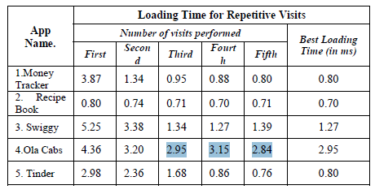
To demonstrate this, load testing was carried out on five progressive web apps, namely Money Tracker, Recipe Book App, Swiggy, Ola Cabs, and Tinder. And the loading time or response time for these apps was recorded for five repeating visits, and the relationship was shown in the below table. [Ref 6]
In the case of Ola Cabs, the response time was 2.95 milliseconds on the third visit, but it increased to 3.15 milliseconds on the fourth visit. Whenever the response time increases on a subsequent visit, it will rise to the same level as it did on the first visit.
Thus, app shells have features such as instant app loading, efficient data use, localized UI and content or data being displayed dynamically, and caching dynamic data to use the app offline.
App Shell's Basic Functioning Concepts –
Shell caching of the web application is handled by the service worker,
and our app shell depends on that cached shell.
The combination of an app shell and dynamic content loading will
boost app performance. To enhance application progressively this is
cached by a Service worker and it works in two steps.
(1) An install event is triggered after a new service worker instance is generated. This install event is handled by the service worker. If the service worker has been installed, the cache is added to the app shell. Following the installation of the service worker, future navigation on the website can be monitored.

Slide 23
(2) If the shell content has been uploaded and the app has requested the same content, the app view is populated. The complete rendered page consists of the app shell as well as dynamic content.
Inside the service worker, there is a fetch event. This fetch event is triggered every time a request is made.
The service worker will stay back in the idle state unless an event is fired. And if it remains idle for a long period then it automatically gets stopped and can be recovered on the occurrence of ‘fetch’ event.
Architectural style and pattern –
For an application, there are 2 main rendering styles. SSR (Server-Side Rendering) and CSR (Client-Side Rendering). The resources like HTML, CSS, and JavaScript files as well as multimedia files are being used while rendering the web app. Apart from these local files if any API is called then these files also should be rendered on a web page.
Every single-page application, whether it is aware of it or not, already uses an app shell.
SSR (Server-Side Rendering) is an effective architectural technique that is widely used in software and app development cycles. The HTTP/HTTPS protocol is crucial in this rendering.
Whenever a new API is triggered, the previous DOM is thrown away entirely and new data is rendered, therefore it results in slow loading of content.

Slide 24
JavaScript is an essential part of the Client-Side Rendering (CSR) architectural pattern. When a user requests something in CSR, instead of repopulating the entire page, only the required content is populated.
As the DOM is not updated on every request, this results in an efficient run time.
Benefits of App Shell –
When the user revisits the app, the app shell architecture provides faster performance. Static assets such as HTML, CSS, and JavaScript files are only cached on the first visit; after that, when the app is accessed again, they are loaded instantly. These UI elements are only loaded when the user specifically requests them.
Using the app shell model, you can build a native app-like experience with instant data loading and offline support.
Brief Introduction on service Worker –
Using service worker in combination with the API provided, certain native app-like features can be created. These APIs will be responsible for providing Push notifications and background synchronization. Detailed explanation of these concepts are covered in previous slides from [7-17].

Slide 25
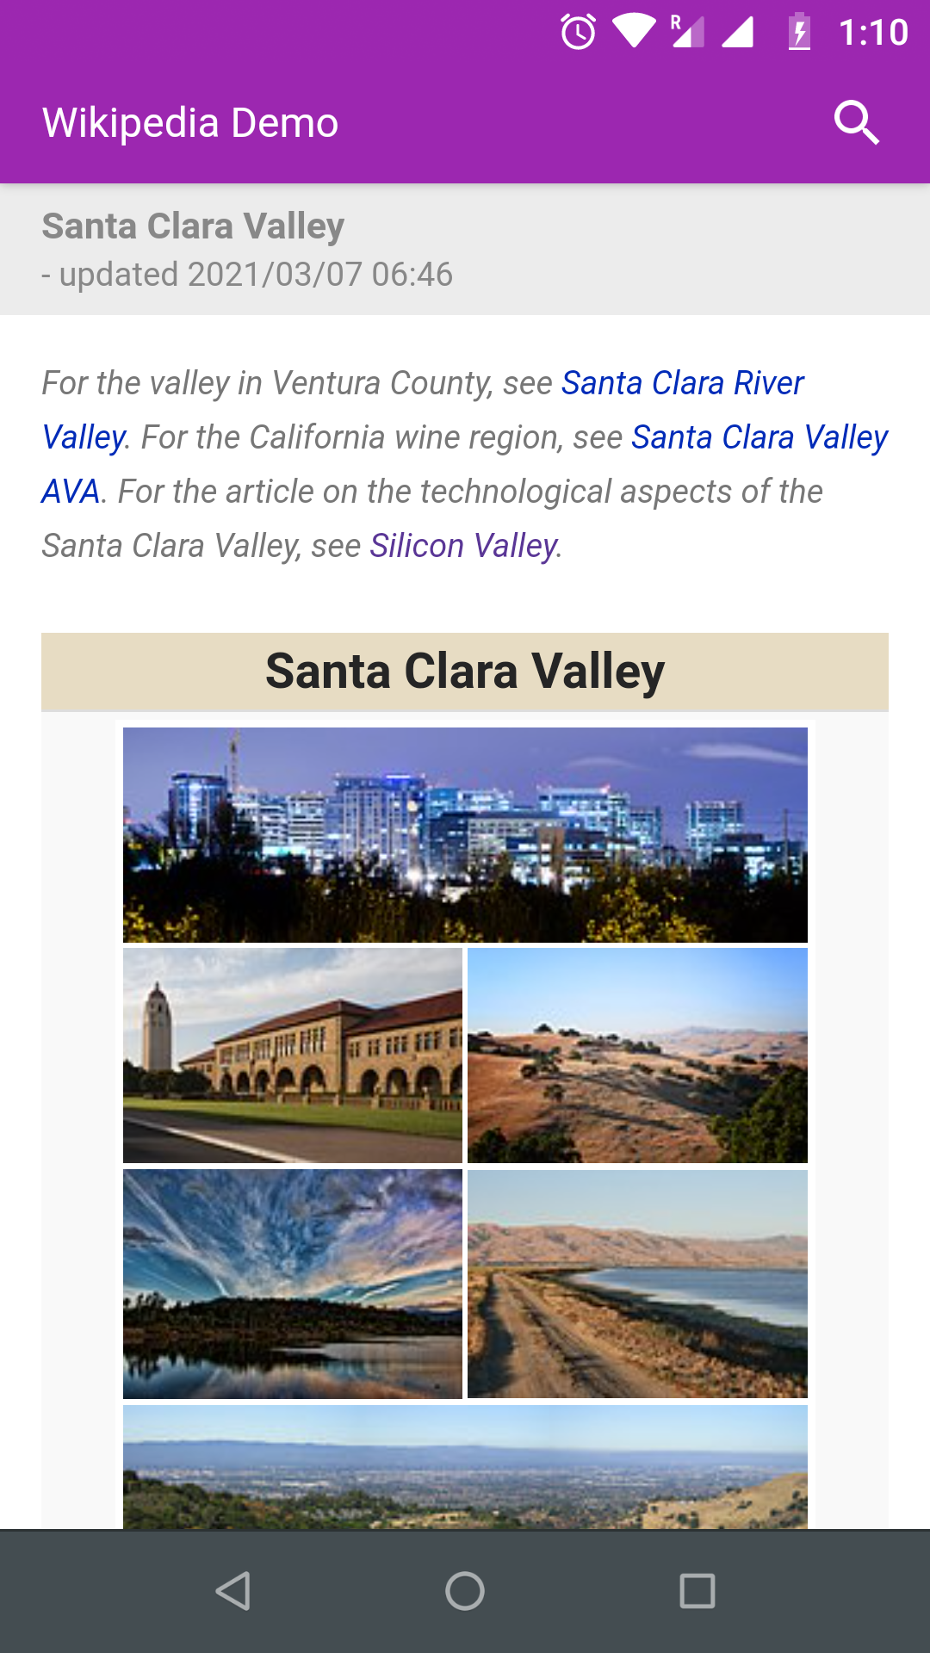
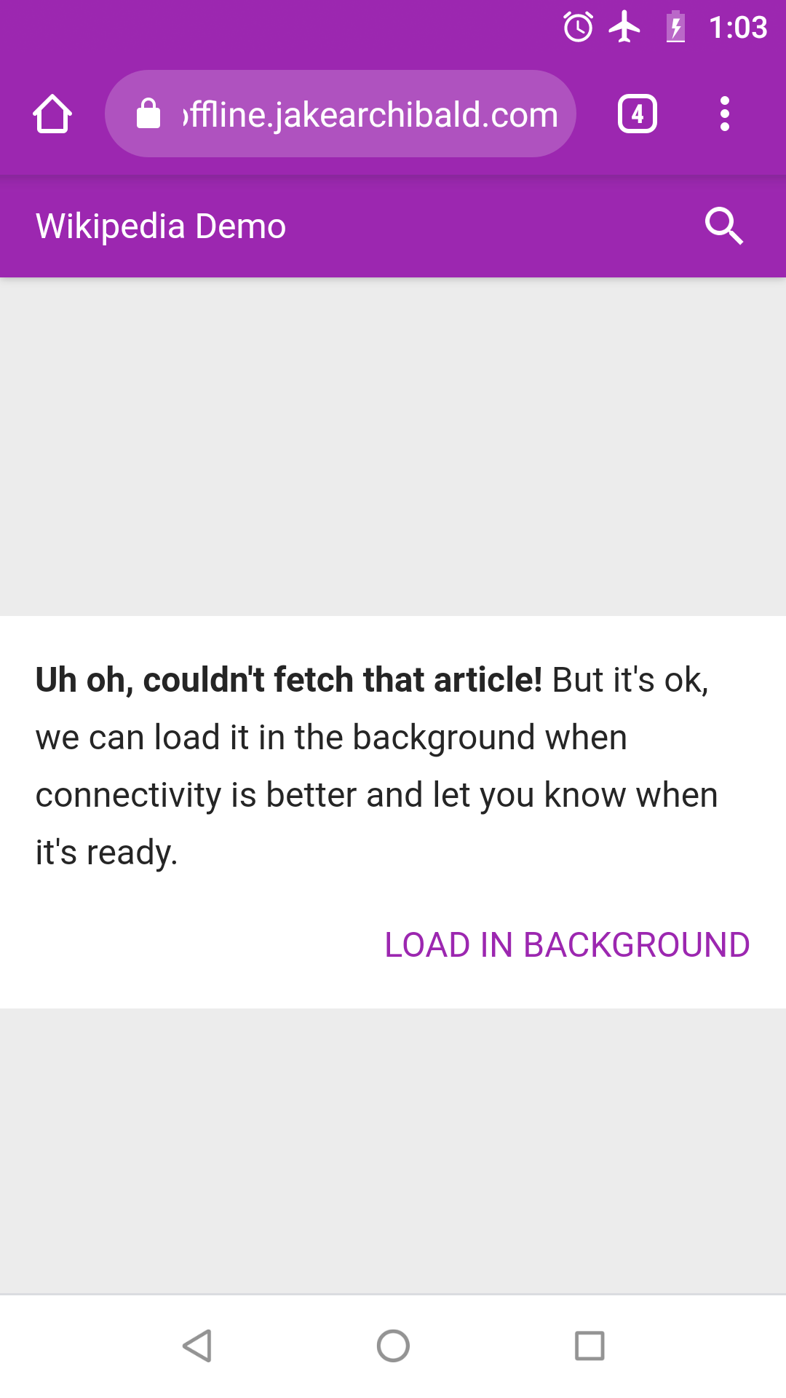
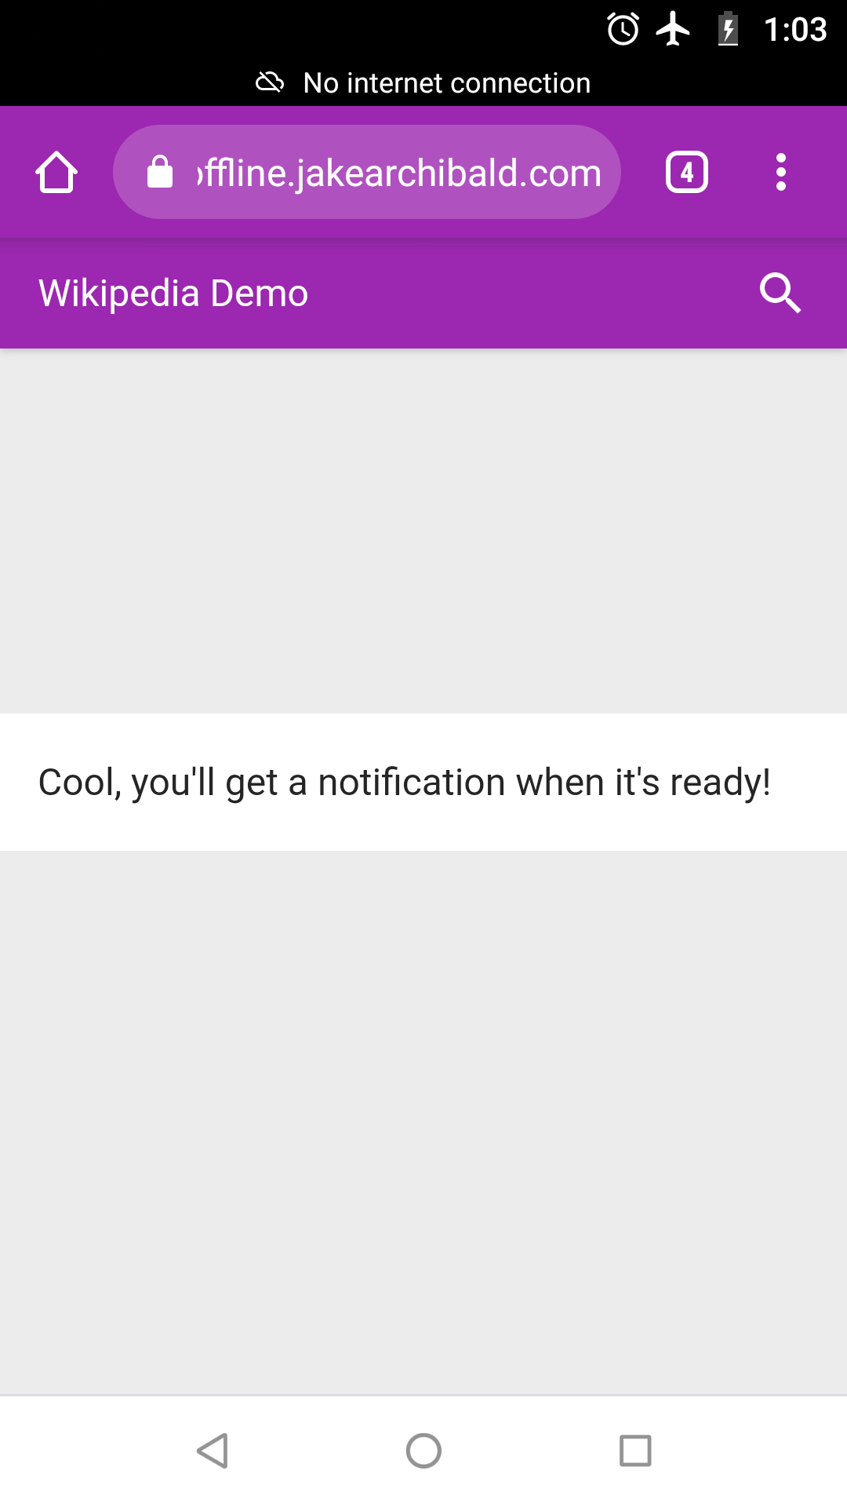
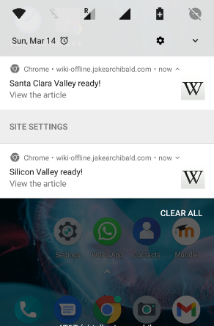
Case study of progressive Features
The paper has provided a case study on “Offline Wikipedia”. The app is built progressively and uses a service worker to the great extent for providing features like background synchronization(When the user requests something in the absence of internet they are populating the app view) and push notification (Once the internet connection is back, even if user’s browser screen is not active this will notify to the user for searched results).
Visualization of this process is shown below.

Slide 26
Lighthouse is an open-source, automated web page quality-improvement tool. Efficiency, usability, progressive web apps, SEO, and other audits are included. And the paper proposes the initial lighthouse test on “offline Wikipedia”.
The application received a performance score of 97, indicating that it was loaded quickly enough regardless of network conditions.
The app was able to achieve a good performance score because it was offline ready, thanks to the use of service workers and the use of App Shell Architecture.
The performance score is given based on three matrices: the first meaningful paint, which is used to major when the primary content of the page is visible. The second matric is the First interactive. This metric marks the time at which the page is minimally interactive. Consistently Interactive was the last metric used. It marks the time at which the entire application gets interactive.
It is observed that performance score on offline Wikipedia results in:
First meaningful paint took 1.6 sec
First interactive took 1.98 sec
After 2 seconds, the full view of the application was loaded, and the website was completely interactive.

Slide 27
Key Takeaways from the paper
PWAs have several advantages over both native and web-based software. The ‘app shell’ architectural pattern allows the app to load much faster as we can check this by running lighthouse testing on the application. The application's efficiency is increased since progressive web applications can be used offline. They do reduce the amount of network bandwidth available.
The application shell should be able to load quickly on repeated visits, cache information, and dynamically display content. It provides the skeleton of the application instantly and it keeps your UI local and pulls in content dynamically through an API.
Service workers, together with background synchronization and push notifications, ensure that the app loads quickly and can make a request even when there is no internet connection. Requests are cached and API call is done in the backend once the device gets online.
Push notification provides the user a native app-like experience, by increasing the user engagement with the app. Once the device gets connected with the internet, the user gets a notification alert regarding requested data if the user has subscribed to push notifications.
Overall, using the application shell and service worker will help to reduce the app loading time and will give users the native-app-like experience with the help of background sync and push notifications.

Slide 28
A few Thoughts on the paper
A detailed explanation of the service worker is provided along with the APIs like push notification and background synchronization, which helps users to understand the workflow of service workers.
Application shell on the other hand helps to understand how application load time can be greatly reduced by caching assets in UI.
I liked the way they did lighthouse performance testing on the existing application (Offline wikipedia), but they could have provided details about it to understand it’s basic functionality.
If they have provided implementation details about service workers, push notifications, background sync, and app shell that would be helpful.
Also, they could have given more insights on reducing the network bandwidth.
Overall paper was good for understanding the theoretical knowledge about PWA.

Slide 29
References
Intro to PWA by Google Chrome developers - https://youtu.be/z2JgN6Ae-Bo?t=26
Rise of PWA - https://labs.thisdot.co/blog/history-of-mobile-web-development-and-the-rise-of-pwa
[ref1]: https://labs.thisdot.co/blog/history-of-mobile-web-development-and-the-rise-of-pwa
[ref2]: https://developers.google.com/web/updates/2015/12/background-sync#what_could_i_use_background_sync_for
What are PWA’s - https://web.dev/what-are-pwas/
Comparison Native vs. PWA - https://www.imaginarycloud.com/blog/native-vs-hybrid-vs-pwa-the-pros-and-cons/
Alex Russel on PWA - https://infrequently.org/2015/06/progressive-apps-escaping-tabs-without-losing-our-soul/
What is PWA by Google - https://developers.google.com/web/updates/2015/12/getting-started-pwa
Background Sync by Google - https://developers.google.com/web/updates/2015/12/background-sync
[ref 3]: Service worker by Google - https://developers.google.com/web/fundamentals/primers/service-workers
[ref 4]: Push notification by Google - https://developers.google.com/web/fundamentals/push-notifications
PWA Example by Google - https://developers.google.com/web/showcase/2017/bookmyshow
[ref 5] BookMyShow - https://developers.google.com/web/showcase/2017/bookmyshow
Asda George - https://developers.google.com/web/showcase/2018/asda-george
Offline Wikipedia - https://wiki-offline.jakearchibald.com/wiki/Silicon_Valley
PWA Candies custom example - https://github.com/PrasannaSasne/PWA_Candies
Web App deployed on GitHub - https://prasannasasne.github.io/PWA_Candies/

Slide 30
[ref 6] : Reference paper -

